Slide 1




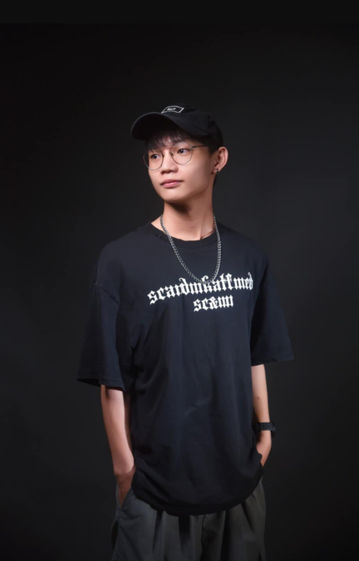


Software engineering midtrem report
MEET U
https://github.com/MEETU.github.io
Infomation
Management,NTPU
Guan-Yi Wu
(Jack)
Infomation
Management, NTPU
Zhong-Rui Tsai (Jerry)
Smart Healthcare and Management, NTPU
Najeeb Ullah
(Nur)
Instructor：Min-Yuh Day
GROUP 5
Data：2025/04/09

Slide 2

CATALOG
01
04
RESEARCH BACKGROUND
BUSINESS MODEL
02
05
RESEARCH MOTIVATION
EXPECTED RESULTS
03
RESEARCH OBJECTIVES
Meet U

Slide 3
TABLE OF CONTENT
Presenter
01
RESEARCH BACKGROUND
02
RESEARCH MOTIVATION
03
RESEARCH OBJECTIVES
Smart Healthcare and Management, NTPU
Najeeb Ullah(Nur)
Thynk Unlimited

Slide 4

1. Background
BACKGROUND
Always Online, Rarely Connected
Digital communication has become essential in modern life
Social media and messaging apps have transformed human interaction
Technological advancement ≠ deeper personal connections
Overreliance Online may lead to:
Social isolation
Weakened emotional bonds
Increased feelings of loneliness
Thynk Unlimited
1

Slide 5

LIMITATIONS OF EXISTING SOCIAL PLATFORMS
While platforms like Facebook, Instagram, and LinkedIn enable people to stay connected, they lack structured mechanisms to facilitate real-world interactions. Traditional social networking applications often:
Focus on virtual engagement, leading to fewer face-to-face conversations.
Struggle to match users effectively based on common interests.
Fail to build trust among strangers meeting for the first time.
Thynk Unlimited
2

Slide 6
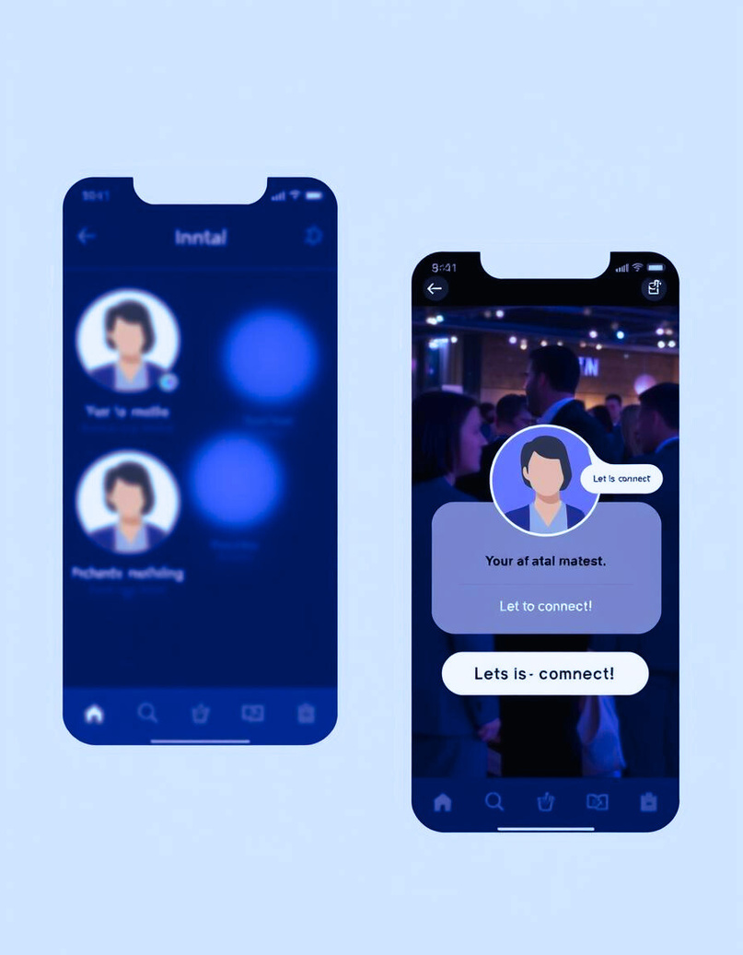
HOW "MEET U"
SOLVES THESE CHALLENGES
"MEET U" is a data-driven social networking application that enables users to meet in small, anonymous dinner gatherings.
Unlike conventional platforms, it:
Allows users to register anonymously, reducing social anxiety.
Matches individuals based on shared interests and hobbies to form compatible groups.
Reveals identities only on the day of the event, creating an exciting and engaging social experience.
Encourages real-world interactions, fostering genuine relationships.
By addressing these issues, "MEET.U" provides a structured and trust-building approach.
Thynk Unlimited
3

Slide 7

1. MOTIVATION
Why is this Project Important?
Many people today find it difficult to initiate conversations or meet new people due to busy schedules, social anxiety, or lack of structured opportunities.
Traditional networking platforms do not offer a safe and engaging environment for users to form connections.
The anonymity and structured matching system of "MEET.U" provides a practical and psychologically comfortable solution to these challenges.
.
Thynk Unlimited
4

Slide 8

2. MOTIVATION
2.Encouraging Face-to-Face Communication
Despite the convenience of digital interactions, real-world communication is essential for emotional bonding. Research suggests that face-to-face meetings:
Strengthen trust and empathy.
Enhance mental well-being.
This leads to more meaningful and lasting connections.
By creating small, intimate dinner gatherings, "MEET.U" promotes real-world interactions in a comfortable and structured setting
Thynk Unlimited
5

Slide 9

3. MOTIVATION
3.The Role of Data-Driven Matching
"MEET.U" improves the social experience by using data analytics to create well-matched groups.
Users answer a set of interest-based questions, and the system matches them with individuals who share similar preferences. This:
Increases the likelihood of meaningful conversations.
Reduces awkwardness and discomfort.
Creates a memorable and enjoyable social experience.
Thynk Unlimited
6

Slide 10

1. OBJECTIVE
Key Point:
Create a Social Networking Platform for Meaningful Connections
1.Evaluating the Effectiveness of Anonymous Social Gatherings
How comfortable users feel when meeting new people anonymously
Whether anonymity helps reduce social anxiety
How effectively participants build connections in a structured setting
Thynk Unlimited
7

Slide 11
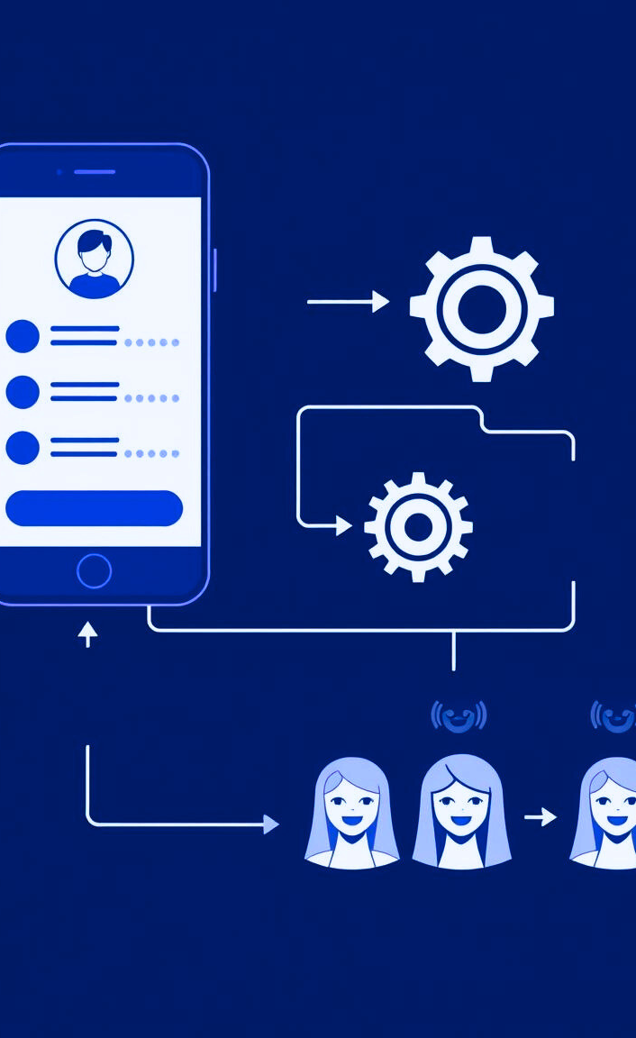
2. OBJECTIVE
2. Investigating the Impact of Data-Driven Matching
The second objective is to analyze how the matching algorithm improves user experience. The project will evaluate:
Whether participants feel that they were matched with like-minded individuals.
How matching influences the quality and depth of conversations.
If data-driven group formation enhances user engagement.
Thynk Unlimited
8

Slide 12

3. OBJECTIVE
3. Developing a Framework for Future Social Networking Applications
Finally, the project aims to create a scalable model that can be applied to other social and professional networking events. The study will:
Establish guidelines on how anonymity and matching can improve social experiences.
Provide insights into user behavior in structured social settings.
Offer recommendations for future networking platforms in various industries, including dining, travel, and business networking.
Thynk Unlimited
9

Slide 13
TABLE OF CONTENT
Presenter
We will show a future business model canvas.
04
BUSINESS MODEL
Infomation
Management, NTPU
Guan-Yi Wu (Jack)

Slide 14
MEET U
BUSINESS MODEL
Key Partners
Key Activities
Value Proposition
Customer Relationships
Customer Segments
Social Media Influencers (KOL)
Event venue organizer
App Maintenance
Marketing campaigns
Safety Monitoring
Improve communication skills
Interest-Based Connections
Encouraging Real-World Engagement
Get new buddies/Friends
Personalized Recommendations
Digital platform
Young People
Introverts or Socially Anxious Individuals
Hobbyists and Interest Groups
Key Resources
Channels
Mobile App Platform
Cloud Infrastructure
Moderation Team
Marketing Team
Mobile App Stores
Social Media Marketing
Cost Structure
Revenue Streams
Development Costs
Marketing Expenses
hosting and data storage
Premium Features
In-App Advertising
Partnership Commissions
10

Slide 15
MEET U
BUSINESS MODEL
Key Partners
Key Activities
Value Proposition
Customer Relationships
Customer Segments
Social Media Influencers (KOL)
Event venue organizer
App Maintenance
Marketing campaigns
Safety Monitoring
Improve communication skills
Interest-Based Connections
Encouraging Real-World Engagement
Get new buddies/Friends
Personalized Recommendations
Digital platform
Young People
Introverts or Socially Anxious Individuals
Hobbyists and Interest Groups
Key Resources
Channels
Mobile App Platform
Cloud Infrastructure
Moderation Team
Marketing Team
Mobile App Stores
Social Media Marketing
Cost Structure
Revenue Streams
Development Costs
Marketing Expenses
hosting and data storage
Premium Features
In-App Advertising
Partnership Commissions
11
Notes:
Starting with customer segments on the right, we’re targeting young people aged 18-35, introverts or socially anxious individuals, and hobbyists with specific interests like board games or hiking. They all crave meaningful offline connections.
首先，我們的目標客層在右邊，包括18-35歲的年輕人、內向或社交焦慮的人，以及有特定興趣的愛好者，比如喜歡桌遊或爬山的人。他們都渴望真實的線下連結。

Slide 16
MEET U
BUSINESS MODEL
Key Partners
Key Activities
Value Proposition
Customer Relationships
Customer Segments
Social Media Influencers (KOL)
Event venue organizer
App Maintenance
Marketing campaigns
Safety Monitoring
Improve communication skills
Interest-Based Connections
Encouraging Real-World Engagement
Get new buddies/Friends
Personalized Recommendations
Digital platform
Young People
Introverts or Socially Anxious Individuals
Hobbyists and Interest Groups
Key Resources
Channels
Mobile App Platform
Cloud Infrastructure
Moderation Team
Marketing Team
Mobile App Stores
Social Media Marketing
Cost Structure
Revenue Streams
Development Costs
Marketing Expenses
hosting and data storage
Premium Features
In-App Advertising
Partnership Commissions
12
Notes:
Next, our value propositions: the app offers anonymity until the meetup day to reduce social anxiety, matches users based on interests, encourages real-world engagement, and creates a safe environment to make new friends.
這款APP的價值主張在這裡：它提供匿名性，直到聚會當天才公開身份，降低社交壓力；根據興趣配對用戶，促進真實交流；並創造安全環境，讓大家結交新朋友。

Slide 17
MEET U
BUSINESS MODEL
Key Partners
Key Activities
Value Proposition
Customer Relationships
Customer Segments
Social Media Influencers (KOL)
Event venue organizer
App Maintenance
Marketing campaigns
Safety Monitoring
Improve communication skills
Interest-Based Connections
Encouraging Real-World Engagement
Get new buddies/Friends
Personalized Recommendations
Digital platform
Young People
Introverts or Socially Anxious Individuals
Hobbyists and Interest Groups
Key Resources
Channels
Mobile App Platform
Cloud Infrastructure
Moderation Team
Marketing Team
Mobile App Stores
Social Media Marketing
Cost Structure
Revenue Streams
Development Costs
Marketing Expenses
hosting and data storage
Premium Features
In-App Advertising
Partnership Commissions
13
Notes:
To reach users, we’ll use these channels: the app will be available on iOS and Android app stores, and we’ll run marketing campaigns on social media platforms like Instagram and TikTok to attract our audience.
我們透過這些通路接觸用戶：APP會上架iOS和Android應用商店，並在社群媒體如Instagram和TikTok做行銷，吸引目標族群。

Slide 18
MEET U
BUSINESS MODEL
Key Partners
Key Activities
Value Proposition
Customer Relationships
Customer Segments
Social Media Influencers (KOL)
Event venue organizer
App Maintenance
Marketing campaigns
Safety Monitoring
Improve communication skills
Interest-Based Connections
Encouraging Real-World Engagement
Get new buddies/Friends
Personalized Recommendations
Digital platform
Young People
Introverts or Socially Anxious Individuals
Hobbyists and Interest Groups
Key Resources
Channels
Mobile App Platform
Cloud Infrastructure
Moderation Team
Marketing Team
Mobile App Stores
Social Media Marketing
Cost Structure
Revenue Streams
Development Costs
Marketing Expenses
hosting and data storage
Premium Features
In-App Advertising
Partnership Commissions
14
Notes:
For customer relationships, we provide a digital platform for users to schedule meetups on their own, and we’ll keep them engaged with personalized recommendations, like suggesting events based on their interests.
在顧客關係方面，我們提供數位平台讓用戶自助安排聚會，並透過個人化推薦，比如根據興趣建議活動，來維持用戶參與。

Slide 19
MEET U
BUSINESS MODEL
Key Partners
Key Activities
Value Proposition
Customer Relationships
Customer Segments
Social Media Influencers (KOL)
Event venue organizer
App Maintenance
Marketing campaigns
Safety Monitoring
Improve communication skills
Interest-Based Connections
Encouraging Real-World Engagement
Get new buddies/Friends
Personalized Recommendations
Digital platform
Young People
Introverts or Socially Anxious Individuals
Hobbyists and Interest Groups
Key Resources
Channels
Mobile App Platform
Cloud Infrastructure
Moderation Team
Marketing Team
Mobile App Stores
Social Media Marketing
Cost Structure
Revenue Streams
Development Costs
Marketing Expenses
hosting and data storage
Premium Features($5-$10 a month)
In-App Advertising
Partnership Commissions
15
Notes:
Revenue streams are listed below: we’ll offer premium features like advanced filters for $5-$10 a month, in-app advertising, and earn commissions from partnered venues.
收入來源在下方，包括增值功能收費，比如進階篩選每月5-10美元；還有應用內廣告，以及與場地合作的佣金。

Slide 20
MEET U
BUSINESS MODEL
Key Partners
Key Activities
Value Proposition
Customer Relationships
Customer Segments
Social Media Influencers (KOL)
Event venue organizer
App Maintenance
Marketing campaigns
Safety Monitoring
Improve communication skills
Interest-Based Connections
Encouraging Real-World Engagement
Get new buddies/Friends
Personalized Recommendations
Digital platform
Young People
Introverts or Socially Anxious Individuals
Hobbyists and Interest Groups
Key Resources
Channels
Mobile App Platform
Cloud Infrastructure
Moderation Team
Marketing Team
Mobile App Stores
Social Media Marketing
Cost Structure
Revenue Streams
Development Costs
Marketing Expenses
hosting and data storage
Premium Features
In-App Advertising
Partnership Commissions
16
Notes:
To make this work, we need key resources: a secure app platform, cloud infrastructure, a moderation team for safety, and a marketing team to grow our user base.
要實現這些，我們需要關鍵資源：一個安全的APP平台、雲端基礎設施、監管團隊確保安全，以及行銷團隊來推廣。

Slide 21
MEET U
BUSINESS MODEL
Key Partners
Key Activities
Value Proposition
Customer Relationships
Customer Segments
Social Media Influencers (KOL)
Event venue organizer
App Maintenance
Marketing campaigns
Safety Monitoring
Improve communication skills
Interest-Based Connections
Encouraging Real-World Engagement
Get new buddies/Friends
Personalized Recommendations
Digital platform
Young People
Introverts or Socially Anxious Individuals
Hobbyists and Interest Groups
Key Resources
Channels
Mobile App Platform
Cloud Infrastructure
Moderation Team
Marketing Team
Mobile App Stores
Social Media Marketing
Cost Structure
Revenue Streams
Development Costs
Marketing Expenses
hosting and data storage
Premium Features
In-App Advertising
Partnership Commissions
17
Notes:
Our key activities include app development and maintenance, marketing campaigns, safety monitoring, and improving communication skills through event design.
關鍵活動包括APP的開發與維護、行銷推廣、確保安全的監控措施，以及提升用戶溝通技巧的活動設計。

Slide 22
MEET U
BUSINESS MODEL
Key Partners
Key Activities
Value Proposition
Customer Relationships
Customer Segments
Social Media Influencers (KOL)
Event venue organizer
App Maintenance
Marketing campaigns
Safety Monitoring
Improve communication skills
Interest-Based Connections
Encouraging Real-World Engagement
Get new buddies/Friends
Personalized Recommendations
Digital platform
Young People
Introverts or Socially Anxious Individuals
Hobbyists and Interest Groups
Key Resources
Channels
Mobile App Platform
Cloud Infrastructure
Moderation Team
Marketing Team
Mobile App Stores
Social Media Marketing
Cost Structure
Revenue Streams
Development Costs
Marketing Expenses
hosting and data storage
Premium Features
In-App Advertising
Partnership Commissions
18
Notes:
We’ll rely on key partners like social media influencers for promotion and event venues to provide meetup locations, as shown on the left.
我們需要合作夥伴，比如社群媒體網紅幫忙宣傳、活動場地提供聚會地點，這些都在左邊列出。

Slide 23
MEET U
BUSINESS MODEL
Key Partners
Key Activities
Value Proposition
Customer Relationships
Customer Segments
Social Media Influencers (KOL)
Event venue organizer
App Maintenance
Marketing campaigns
Safety Monitoring
Improve communication skills
Interest-Based Connections
Encouraging Real-World Engagement
Get new buddies/Friends
Personalized Recommendations
Digital platform
Young People
Introverts or Socially Anxious Individuals
Hobbyists and Interest Groups
Key Resources
Channels
Mobile App Platform
Cloud Infrastructure
Moderation Team
Marketing Team
Mobile App Stores
Social Media Marketing
Cost Structure
Revenue Streams
Development Costs
Marketing Expenses
hosting and data storage
Premium Features
In-App Advertising
Partnership Commissions
19
Notes:
Finally, our costs: development expenses, marketing costs, server and data storage fees, plus safety and moderation expenses.
最後是成本，包含開發費用、行銷費用、伺服器與數據儲存成本，還有監管與安全措施的支出。
In summary, the Anonymous Meetup App connects people through anonymity and shared interests, helping them overcome social barriers while ensuring sustainability with diverse revenue and partnerships. That’s my presentation—thank you!
總結來說，『匿名聚會APP』透過匿名性與興趣配對，幫助人們克服社交障礙，建立真實連結，並用多元收入與合作確保商業可行性。以上是我的介紹，謝謝大家！

Slide 24
TABLE OF CONTENT
Presenter
05
EXPECTED RESULTS
Information
Management, NTPU
Zhong-Rui Tsai (Jerry)

Slide 25


EXPECTED RESULT
INCREASE USER ENGAGEMENT AND RETENTION
1
BUILDING AN INNOVATIVE PLATFORM
2
Helps people connect through shared interests
Creating a friendly and safe environment
20

Slide 26

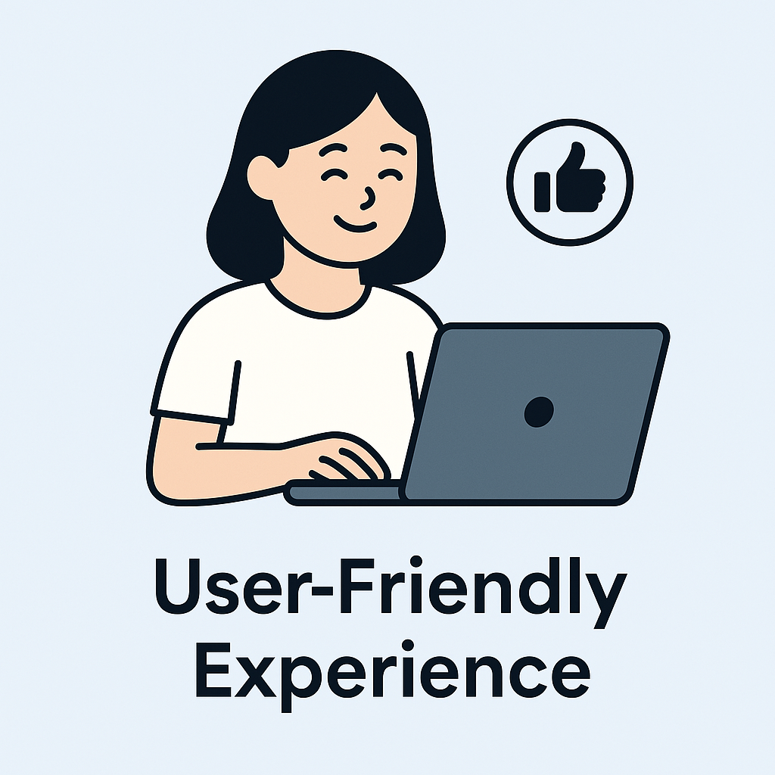
EXPECTED RESULT
3
EVENT SUCCESS RATE OVER 80%
4
CREATING A USER-FRIENDLY EXPERIENCE
Most users who sign up for events will actually be matched and able to join a group.
Make sure the app is easy to use
21

Slide 27
Software engineering midtrem report
MEET U
Q&A
Infomation
Management, NTPU
Guan-Yi Wu
(Jack)
Infomation
Management, NTPU
Zhong-Rui Tsai (Jerry)
Smart Healthcare and Management, NTPU
Najeeb Ullah
(Nur)
Instructor：Min-Yuh Day
GROUP 5
Data：2025/04/09

